Slide 1
The Theme
for the competitive game

Slide 2
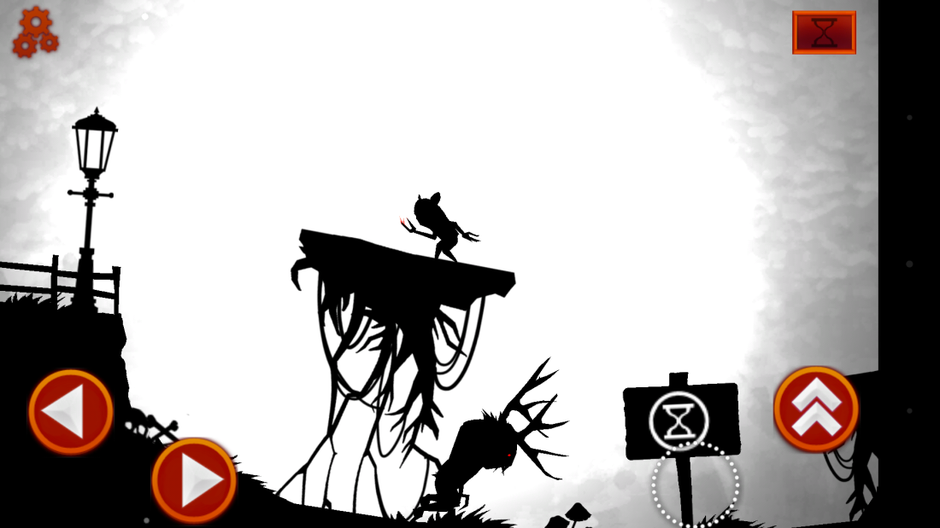
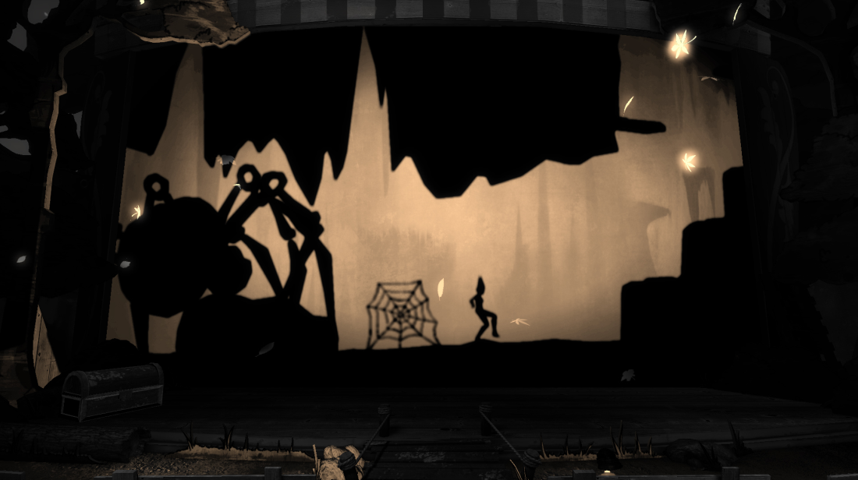
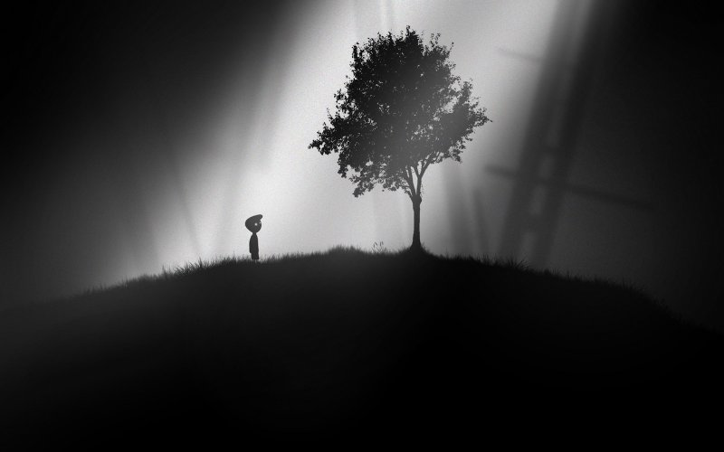
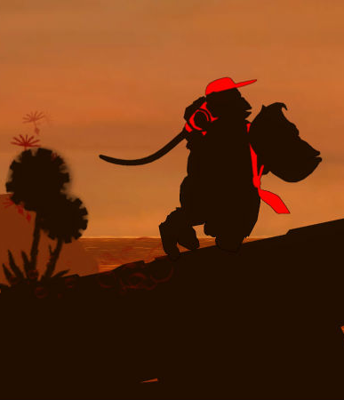

Slide 3
The art style I have chosen to use for this project is an abstract shadow-like one based on silhouettes and used in infamous titles such as ‘Limbo’ or ‘Donkey Kong Country Returns’.
The reasons for choosing this theme are as
follows:

Slide 4
1. It is refreshing
Most ‘platformer’ titles out there are using vividly coloured styles instead of monochrome
Although relatively new, since the release of ‘Limbo’ in 2010, a lot of games have since adopted the simple monochrome theme, meaning it’s been appealing to the gamers out there

Slide 5
2. Simple yet efficient
Considering we are time constrained, the shadow theme is the best choice as the assets are easier to design - meaning more time left to focus on polishing the game rather than delivering an unfinished product, as Dan said.

Slide 6
3. Animations and gameplay
Easier to realise animations considering we will have multiple characters on the screen at all times
Allows for focusing on the actual gameplay, on the action happening on the screen rather than the graphics

